Slide 1
CHAPTER 6
Quantum Mechanics II
6.1 The Schrödinger Wave Equation
6.2 Expectation Values
6.3 Infinite Square-Well Potential
6.4 Finite Square-Well Potential
6.5 Three-Dimensional Infinite-Potential Well
6.6 Simple Harmonic Oscillator
6.7 Barriers and Tunneling
I think it is safe to say that no one understands quantum mechanics. Do not keep saying to yourself, if you can possibly avoid it, “But how can it be like that?” because you will get “down the drain” into a blind alley from which nobody has yet escaped. Nobody knows how it can be like that.
- Richard Feynman

Slide 2
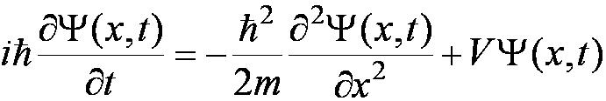
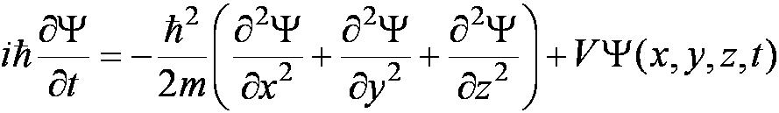

6.1: The Schrödinger Wave Equation
The Schrödinger wave equation in its time-dependent form for a particle of energy E moving in a potential V in one dimension is
The extension into three dimensions is
where is an imaginary number.

Slide 3
General Solution of the Schrödinger Wave Equation
The general form of the wave function is
which also describes a wave moving in the x direction. In general the amplitude may also be complex.
The wave function is also not restricted to being real. Notice that the sine term has an imaginary number. Only the physically measurable quantities must be real. These include the probability, momentum and energy.

Slide 4
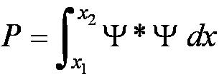
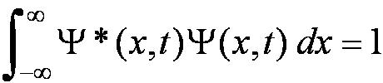
Normalization and Probability
The probability P(x) dx of a particle being between x and X + dx was given in the equation
The probability of the particle being between x₁ and x₂ is given by
The wave function must also be normalized so that the probability of the particle being somewhere on the x axis is 1.

Slide 5
Properties of Valid Wave Functions
Boundary conditions
In order to avoid infinite probabilities, the wave function must be finite everywhere.
In order to avoid multiple values of the probability, the wave function must be single valued.
For finite potentials, the wave function and its derivative must be continuous. This is required because the second-order derivative term in the wave equation must be single valued. (There are exceptions to this rule when V is infinite.)
In order to normalize the wave functions, they must approach zero as x approaches infinity.
Solutions that do not satisfy these properties do not generally correspond to physically realizable circumstances.

Slide 6

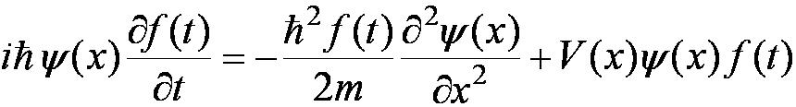
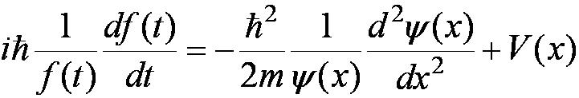
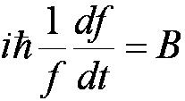
Time-Independent Schrödinger Wave Equation
The potential in many cases will not depend explicitly on time.
The dependence on time and position can then be separated in the Schrödinger wave equation. Let ,
which yields:
Now divide by the wave function:
The left side of Equation (6.10) depends only on time, and the right side depends only on spatial coordinates. Hence each side must be equal to a constant. The time dependent side is

Slide 7
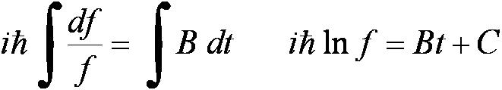
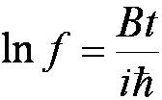

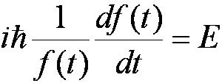
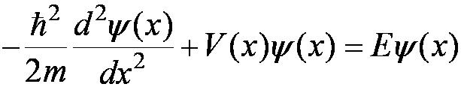
Time-Independent Schrödinger Wave Equation Continued
We integrate both sides and find:
where C is an integration constant that we may choose to be 0. Therefore
This determines f to be
This is known as the time-independent Schrödinger wave equation, and it is a fundamental equation in quantum mechanics.

Slide 8

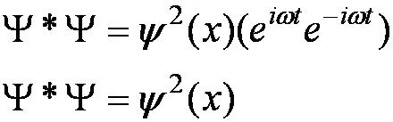
Stationary State
The wave function can be written as:
The probability density becomes:
The probability distributions are constant in time. This is a standing wave phenomena that is called the stationary state.

Slide 9
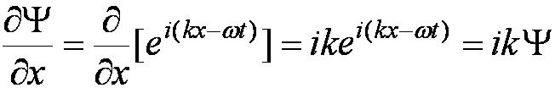
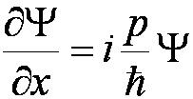
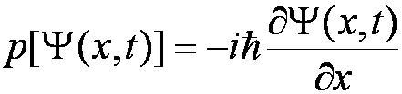
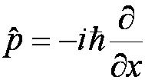
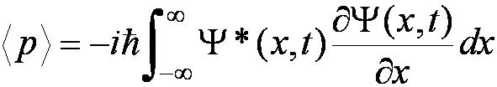
Momentum Operator
To find the expectation value of p, we first need to represent p in terms of x and t. Consider the derivative of the wave function of a free particle with respect to x:
With k = p / ħ we have
This yields
This suggests we define the momentum operator as .
The expectation value of the momentum is

Slide 10
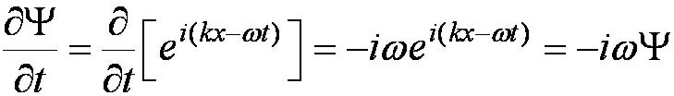
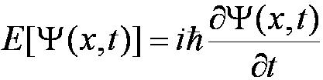
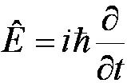
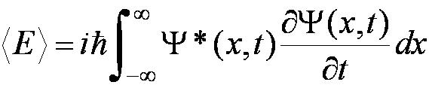
Position and Energy Operators
The position x is its own operator as seen above.
The time derivative of the free-particle wave function is
Substituting ω = E / ħ yields
The energy operator is
The expectation value of the energy is

Slide 11
Comparison of Classical and Quantum Mechanics
Newton’s second law and Schrödinger’s wave equation are both differential equations.
Newton’s second law can be derived from the Schrödinger wave equation, so the latter is the more fundamental.
Classical mechanics only appears to be more precise because it deals with macroscopic phenomena. The underlying uncertainties in macroscopic measurements are just too small to be significant.

Slide 12
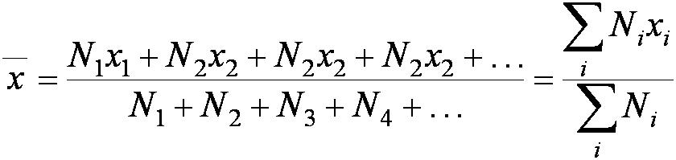
6.2: Expectation Values
The expectation value is the expected result of the average of many measurements of a given quantity. The expectation value of x is denoted by <x>
Any measurable quantity for which we can calculate the expectation value is called a physical observable. The expectation values of physical observables (for example, position, linear momentum, angular momentum, and energy) must be real, because the experimental results of measurements are real.
The average value of x is

Slide 13
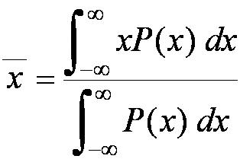
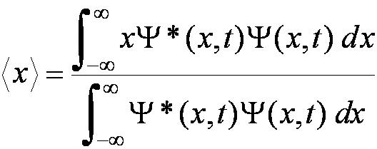
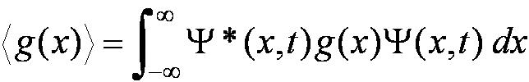
Continuous Expectation Values
We can change from discrete to continuous variables by using the probability P(x,t) of observing the particle at a particular x.
Using the wave function, the expectation value is:
The expectation value of any function g(x) for a normalized wave function:

Slide 14
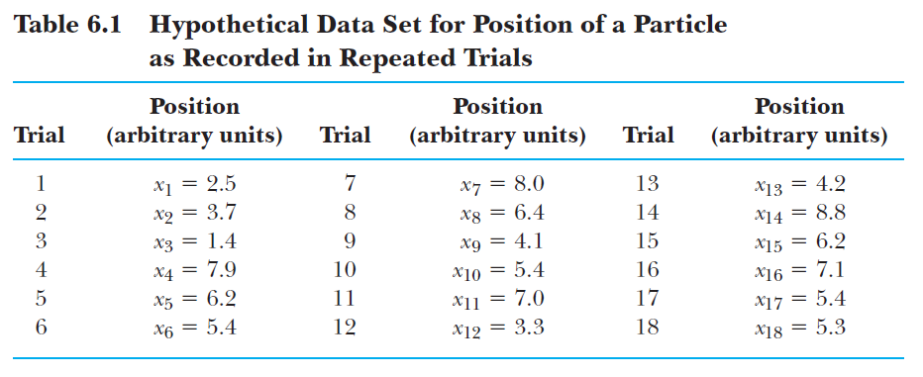

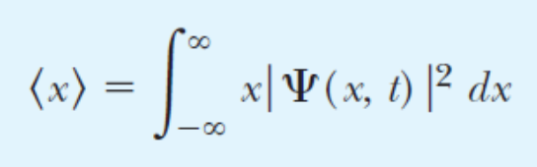
Some expectation values are sharp some others fuzzy
Since there is scatter in the actual positions (x), the calculated expectation value will have an uncertainty, fuzziness (Note that x is its own operator.)

Slide 15
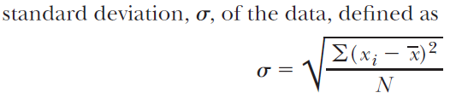
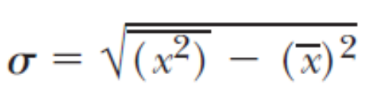

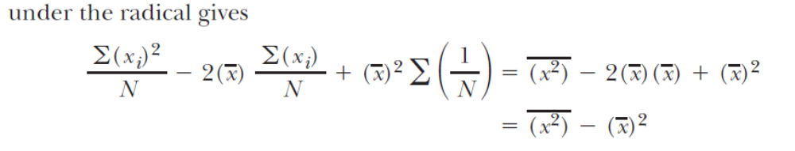

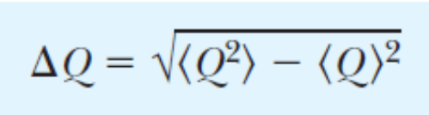
Some expectation values are sharp some others fuzzy, continued I
x may as well stand for any kind of operator Q
If not fuzzy, ΔQ = 0
Because <Q²>= <Q>²
For any observable, fuzzy or not

Slide 16
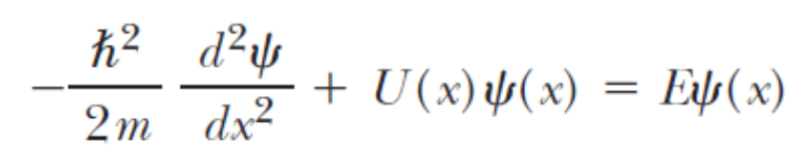
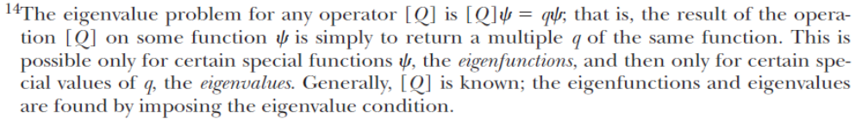
Some expectation values are sharp some others fuzzy, continued II
Eigenvalues of operators are always sharp (an actual – physical - measurement may give some variation in the result, but the calculation gives zero fuzziness
Say Q is the Hamiltonian operator
A wavefunction that solves this equation is an eigenfunction of this operator, E is the corresponding eigenvalue, apply this operator twice and you get E² – which sure is the same as squaring to result of applying it once (E)

Slide 17

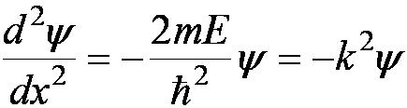


6.3: Infinite Square-Well Potential
The simplest such system is that of a particle trapped in a box with infinitely hard walls that the particle cannot penetrate. This potential is called an infinite square well and is given by
Clearly the wave function must be zero where the potential is infinite.
Where the potential is zero inside the box, the Schrödinger wave
equation becomes where .
The general solution is .

Slide 18
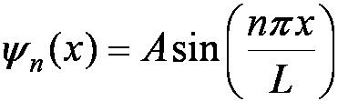
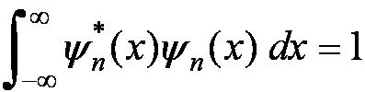
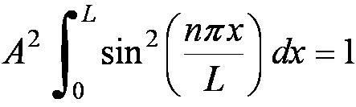
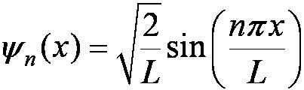
Quantization
Boundary conditions of the potential dictate that the wave function must be zero at x = 0 and x = L. This yields valid solutions for integer values of n such that kL = nπ.
The wave function is now
We normalize the wave function
The normalized wave function becomes
These functions are identical to those obtained for a vibrating string with fixed ends.

Slide 19
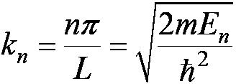
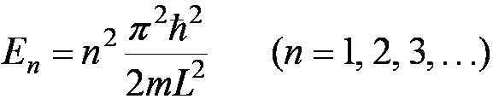
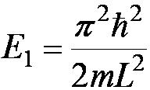
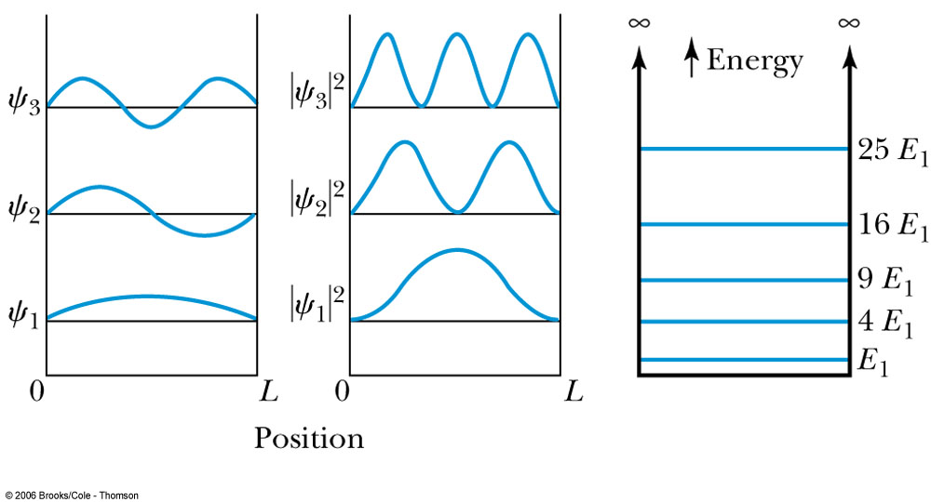
Quantized Energy
The quantized wave number now becomes
Solving for the energy yields
Note that the energy depends on the integer values of n. Hence the energy is quantized and nonzero.
The special case of n = 0 is called the ground state energy.

Slide 20
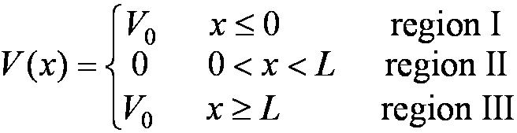
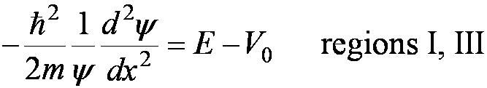

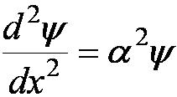
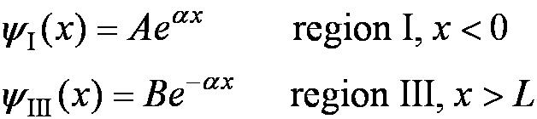
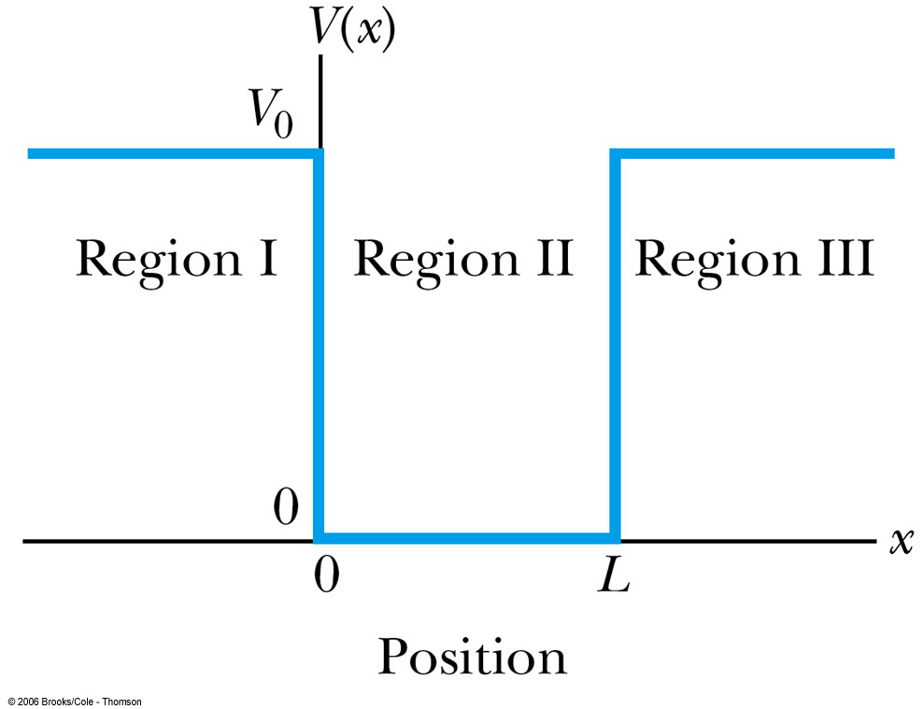
6.4: Finite Square-Well Potential
The finite square-well potential is
The Schrödinger equation outside the finite well in regions I and III is
or using
yields . Considering that the wave function must be zero at infinity, the solutions for this equation are

Slide 21
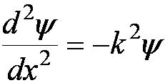

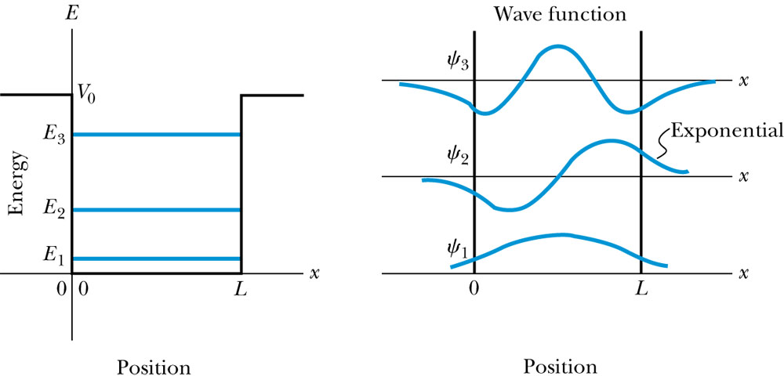
Finite Square-Well Solution
Inside the square well, where the potential V is zero, the wave equation becomes where
Instead of a sinusoidal solution we have
The boundary conditions require that
and the wave function must be smooth where the regions meet.
Note that the
wave function is
nonzero outside
of the box.

Slide 22
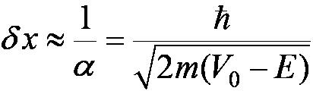
Penetration Depth
The penetration depth is the distance outside the potential well where the probability significantly decreases. It is given by
It should not be surprising to find that the penetration distance that violates classical physics is proportional to Planck’s constant.

Slide 23








6.5: Three-Dimensional Infinite-Potential Well
The wave function must be a function of all three spatial coordinates. We begin with the conservation of energy
Multiply this by the wave function to get
Now consider momentum as an operator acting on the wave function. In this case, the operator must act twice on each dimension. Given:
The three dimensional Schrödinger wave equation is

Slide 24
Degeneracy
Analysis of the Schrödinger wave equation in three dimensions introduces three quantum numbers that quantize the energy.
A quantum state is degenerate when there is more than one wave function for a given energy.
Degeneracy results from particular properties of the potential energy function that describes the system. A perturbation of the potential energy can remove the degeneracy.

Slide 25







6.6: Simple Harmonic Oscillator
Simple harmonic oscillators describe many physical situations: springs, diatomic molecules and atomic lattices.
Consider the Taylor expansion of a potential function:
Redefining the minimum potential and the zero potential, we have
Substituting this into the wave equation:
Let and which yields .

Slide 26


Parabolic Potential Well
If the lowest energy level is zero, this violates the uncertainty principle.
The wave function solutions are where H_{n}(x) are Hermite polynomials of order n.
In contrast to the particle in a box, where the oscillatory wave function is a sinusoidal curve, in this case the oscillatory behavior is due to the polynomial, which dominates at small x. The exponential tail is provided by the Gaussian function, which dominates at large x.

Slide 27




Analysis of the Parabolic Potential Well
The energy levels are given by
The zero point energy is called the Heisenberg limit:
Classically, the probability of finding the mass is greatest at the ends of motion and smallest at the center (that is, proportional to the amount of time the mass spends at each position).
Contrary to the classical one, the largest probability for this lowest energy state is for the particle to be at the center.

Slide 28

Potential Barrier

Slide 33


Slide 34
Potential Barrier

Slide 35




6.7: Barriers and Tunneling
Consider a particle of energy E approaching a potential barrier of height V₀ and the potential everywhere else is zero.
We will first consider the case when the energy is greater than the potential barrier.
In regions I and III the wave numbers are:
In the barrier region we have

Slide 36



Reflection and Transmission
The wave function will consist of an incident wave, a reflected wave, and a transmitted wave.
The potentials and the Schrödinger wave equation for the three regions are as follows:
The corresponding solutions are:
As the wave moves from left to right, we can simplify the wave functions to:

Slide 37


Probability of Reflection and Transmission
The probability of the particles being reflected R or transmitted T is:
The maximum kinetic energy of the photoelectrons depends on the value of the light frequency f and not on the intensity.
Because the particles must be either reflected or transmitted we have: R + T = 1.
By applying the boundary conditions x → ±∞, x = 0, and x = L, we arrive at the transmission probability:
Notice that there is a situation in which the transmission probability is 1.

Slide 38



Tunneling
Now we consider the situation where classically the particle does not have enough energy to surmount the potential barrier, E < V₀.
The quantum mechanical result, however, is one of the most remarkable features of modern physics, and there is ample experimental proof of its existence. There is a small, but finite, probability that the particle can penetrate the barrier and even emerge on the other side.
The wave function in region II becomes
The transmission probability that
describes the phenomenon of tunneling is

Slide 39



Uncertainty Explanation
Consider when κL >> 1 then the transmission probability becomes:
This violation allowed by the uncertainty principle is equal to the negative kinetic energy required! The particle is allowed by quantum mechanics and the uncertainty principle to penetrate into a classically forbidden region. The minimum such kinetic energy is:

Slide 40


Slide 41

Tunneling & Microchip Development
As microchip developers create smaller production processes, we reach the limit of classical computer technology
The feature size of the most advanced microchip today is 45 nm
With such small widths, the electrons in the channel can tunnel out with relative ease, possibly affecting other transistors in the chip
Current approximations show that the minimum feature size is about 4 nm
After that point tunneling is not only possible, but highly likely and the chip would fail

Slide 42

Scanning Tunneling Microscopes
The Scanning Tunneling Microscope was invented in 1981 by Gerd Binnig and Heinrich Rohrer
When a metal tip, usually made of tungsten or platinum-iridium, is brought within .4-.7nm of the sample, electrons tunnel across the gap and create a current in the tip
This current is then fed to a computer and used to generate an image of the atomic surface of the sample
Image courtesy of Wikipedia

Slide 43


At this distance the coulomb force between the tip and an atom of the sample is actually enough to move the atom
This has allowed physicists to create images and structures on the atomic level
Images courtesy of IBM

Slide 44

Analogy with Wave Optics
If light passing through a glass prism reflects from an internal surface with an angle greater than the critical angle, total internal reflection occurs. However, the electromagnetic field is not exactly zero just outside the prism. If we bring another prism very close to the first one, experiments show that the electromagnetic wave (light) appears in the second prism The situation is analogous to the tunneling described here. This effect was observed by Newton and can be demonstrated with two prisms and a laser. The intensity of the second light beam decreases exponentially as the distance between the two prisms increases.

Slide 45

Potential Well
Consider a particle passing through a potential well region rather than through a potential barrier.
Classically, the particle would speed up passing the well region, because K = mv² / 2 = E + V₀.
According to quantum mechanics, reflection and transmission may occur, but the wavelength inside the potential well is smaller than outside. When the width of the potential well is precisely equal to half-integral or integral units of the wavelength, the reflected waves may be out of phase or in phase with the original wave, and cancellations or resonances may occur. The reflection/cancellation effects can lead to almost pure transmission or pure reflection for certain wavelengths. For example, at the second boundary (x = L) for a wave passing to the right, the wave may reflect and be out of phase with the incident wave. The effect would be a cancellation inside the well.

Slide 46

Alpha-Particle Decay
The phenomenon of tunneling explains the alpha-particle decay of heavy, radioactive nuclei.
Inside the nucleus, an alpha particle feels the strong, short-range attractive nuclear force as well as the repulsive Coulomb force.
The nuclear force dominates inside the nuclear radius where the potential is approximately a square well.
The Coulomb force dominates
outside the nuclear radius.
The potential barrier at the nuclear
radius is several times greater than
the energy of an alpha particle.
According to quantum mechanics,
however, the alpha particle can
“tunnel” through the barrier. Hence
this is observed as radioactive decay.

